Slide 1

Opinion dynamics models in empirically justified networks
Joel Wildman

Slide 2
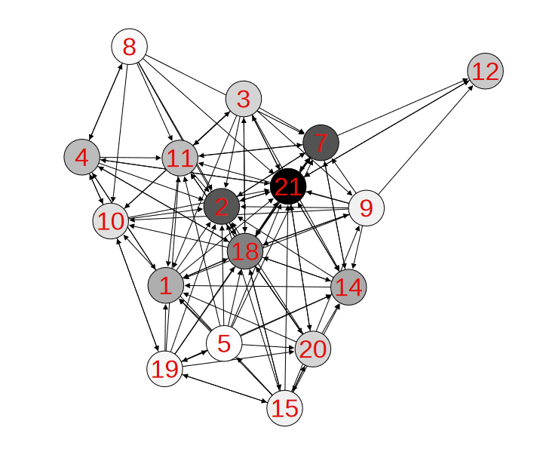
An introduction to social modelling
What are Social Networks?
What are Opinion Dynamics Models?
How can we improve them?
Problem statement
Reduced Krackhardt’s advice network
with 17 nodes, Jia, P., MirTabatabaei, A., Friedkin, N. E., & Bullo, F. (2015). Opinion dynamics and the evolution of social power in influence networks. SIAM review, 57(3), 367-397.

Slide 3
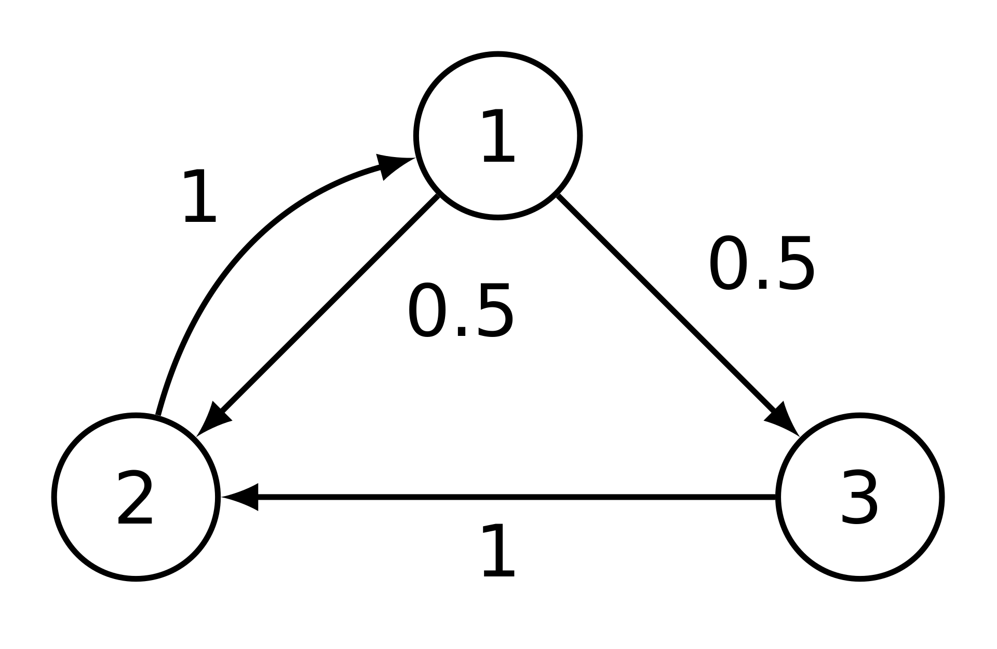
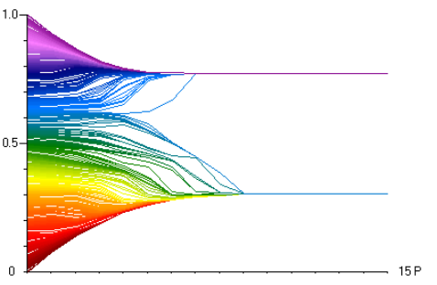
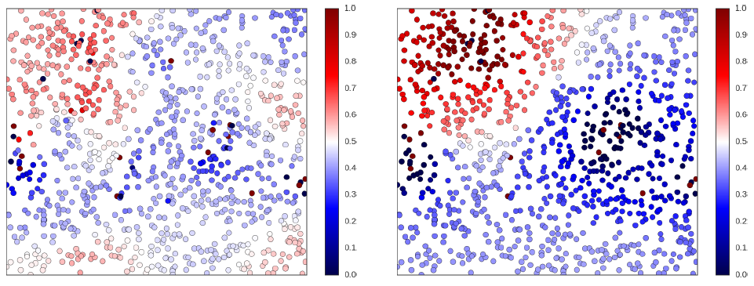
Existing Models
Older Models
Mathematically oriented
Advent of computer simulation
Modern models
Example of convergent network in the DeGroot Model
Hegselmann-Krause bounded confidence model
Rainer, H., & Krause, U. (2002). Opinion dynamics and bounded confidence: models, analysis and simulation.
Peter Duggins’ social influence model environment
Duggins, P. (2014). A psychologically-motivated model of opinion change with applications to American politics. arXiv preprint arXiv:1406.7770.
Notes:
Old models:
well defined by mathematical functions
often exhibited simple behaviour
homogenous agents
linear functions
New models:
driven by simulation
heterogeneous models and persistently complex behaviour
Characteristics of real opinions:
(a) diversity of opinions across society, (b) opinion subcultures, and (c) pluralistic ignoranc

Slide 4
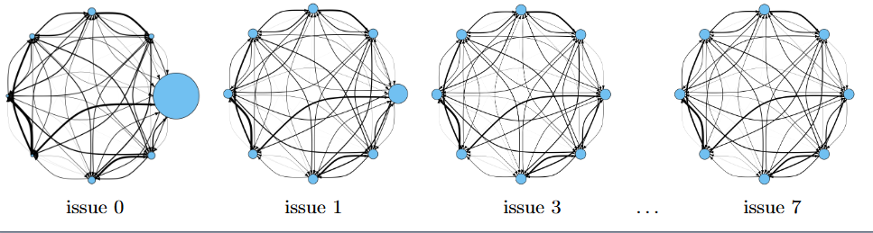
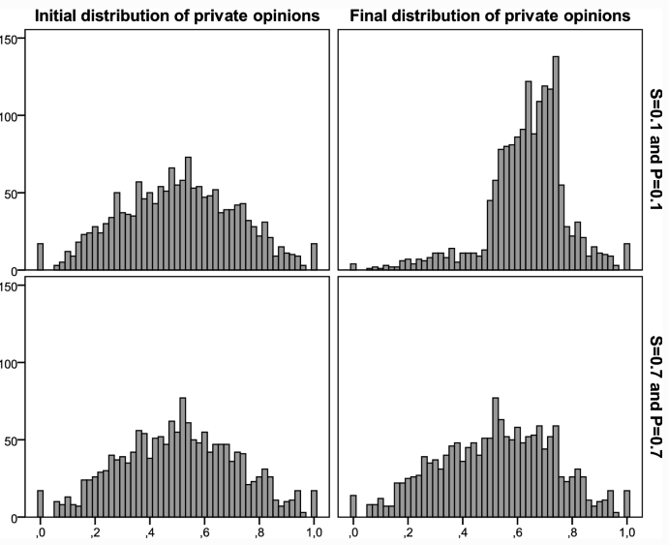
Which are right for us?
DeGroot-Friedkin model
Mathematical basis
Preference Falsification Simulation model
Psychologically driven, complex system
Jia, P., MirTabatabaei, A., Friedkin, N. E., & Bullo, F. (2015). Opinion dynamics and the evolution of social power in influence networks. SIAM review, 57(3), 367-397.
VS
León-Medina, F. J., Tena-Sánchez, J., & Miguel, F. J. (2020). Fakers becoming believers: how opinion dynamics are shaped by preference falsification, impression management and coherence heuristics. Quality & Quantity, 54(2), 385-412.

Slide 5
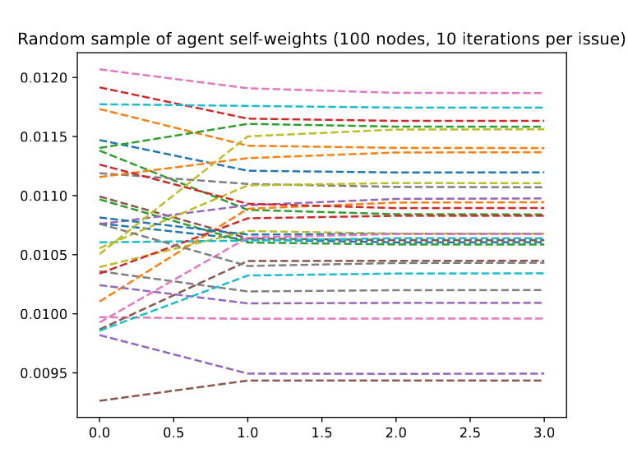
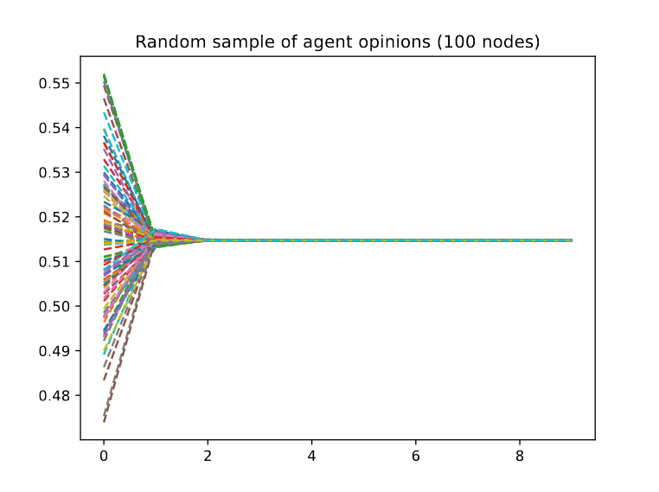
DeGroot-Friedkin model overview
General principle
Update rules
Environment
Issue
Opinion
DGF self weights over 10 issues, 100 node complete graph
Iteration
DGF opinions over 10 issues, 100 node complete graph

Slide 6
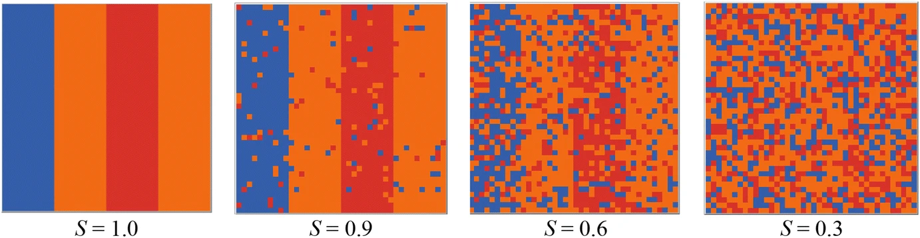
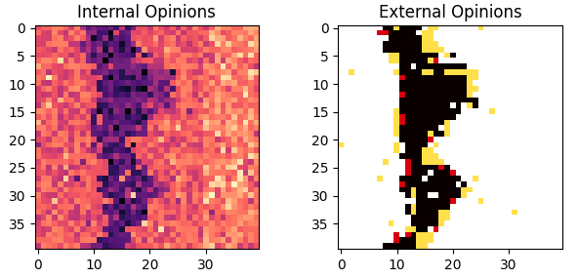
Preference Falsification Simulation model
Guiding principles
Update rules
Environment
Class distribution across segregation levels.
Internal and External opinion distributions after 30 iterations

Slide 7
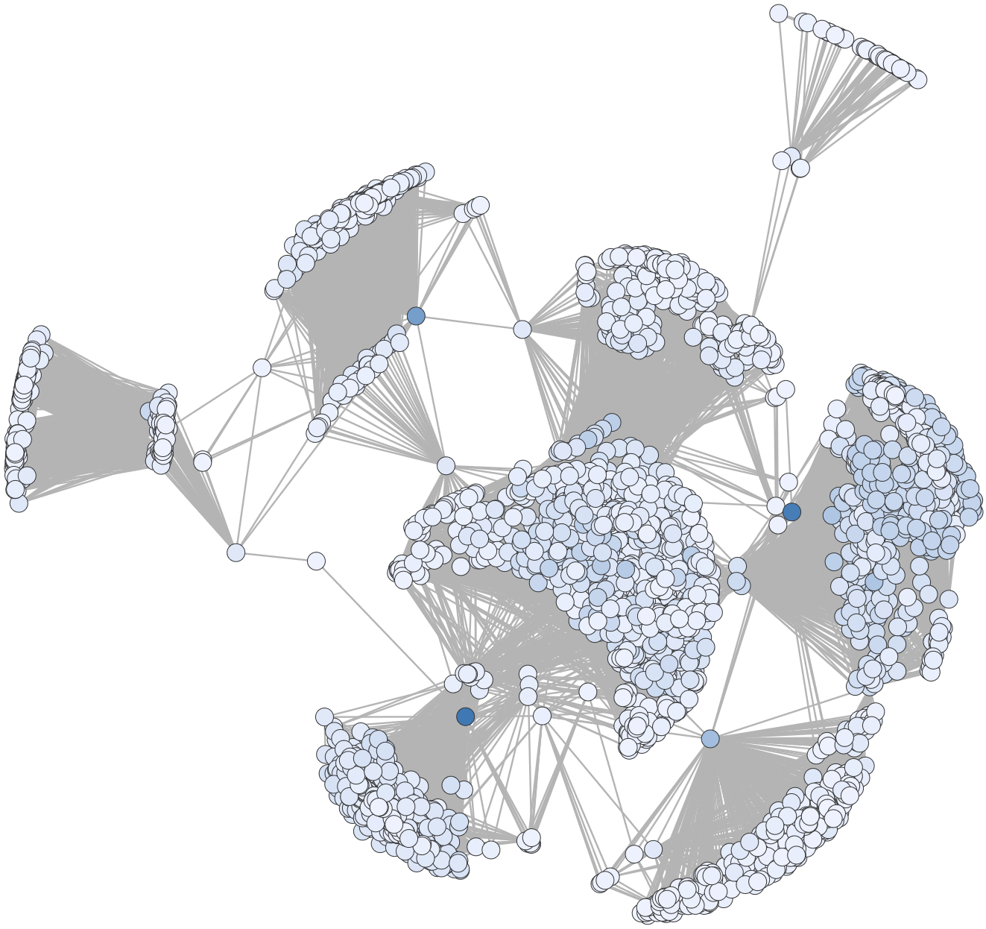
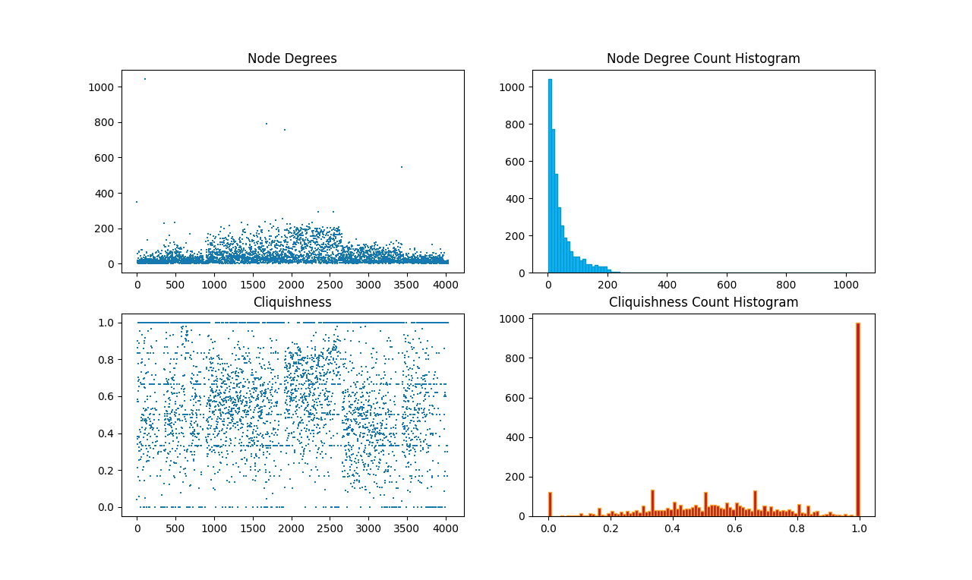
The Facebook Dataset
SNAP origins
Network details & characteristics
Why does this represent an actual social network?
Why is it good for us?
Notes:
Stanford network analysis project
Cliquishness: define
Degree: ~44, stdev of 25, median of 52

Slide 8
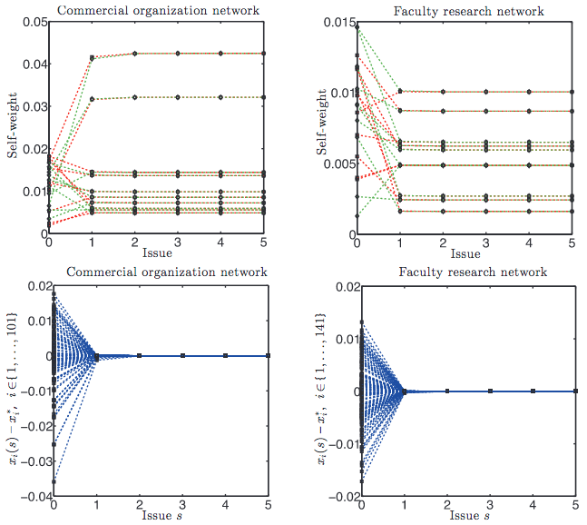
Modifications to the Models
DGF on complete directed graphs
Undirected Facebook graph
Arbitrary weights (discussed later)
Agent self-weight in networks with 101 and 141 nodes respectively. The bottom figures show the error between the self-weight trajectory and equilibrium value.
Jia, P., MirTabatabaei, A., Friedkin, N. E., & Bullo, F. (2015). Opinion dynamics and the evolution of social power in influence networks. SIAM review, 57(3), 367-397.
Notes:
Arbitrary weights are the interpersonal weights we generate
Ultimately minimal changes to model

Slide 9
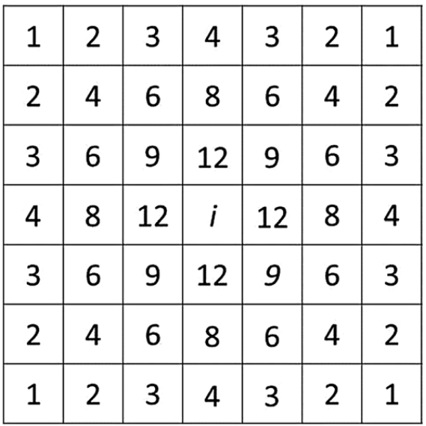
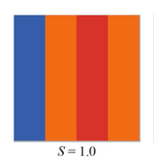
Modifications to the Models
PFS environment incompatibility
Grids as an 8-regular graph
Neighbourhoods with DFS
Number of possible neighbourhoods shared with agent i
Fully segregated agents in grid format
Notes:
GET STATISTICS FOR AVERAGE NEIGHBOURHOOD SIZE N STUFF

Slide 10
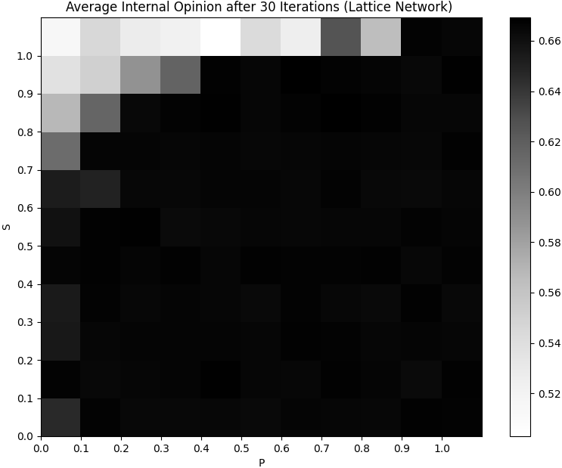
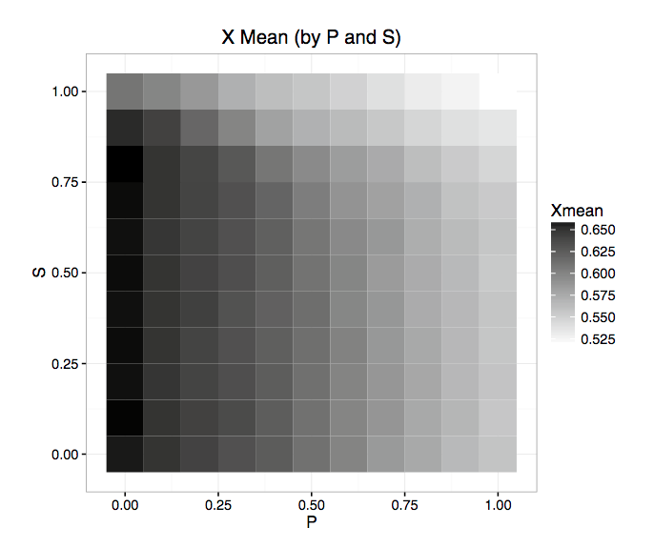
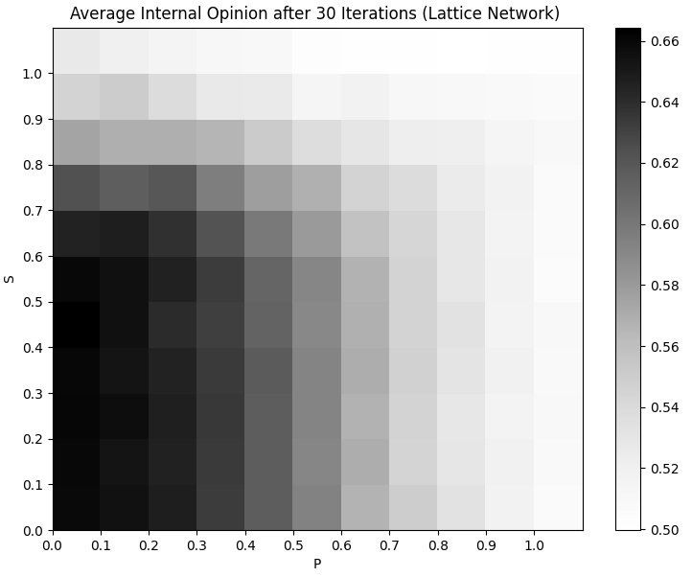
Modifications to the Models
Internal vs External opinions for agent ro_{i}
Model outcomes when global opinion contributes to ro_{i}
?
Model outcomes from paper
Model outcomes when internal opinion contributes to ro_{i}
Notes:
Explain PFS justification for both outcomes

Slide 11
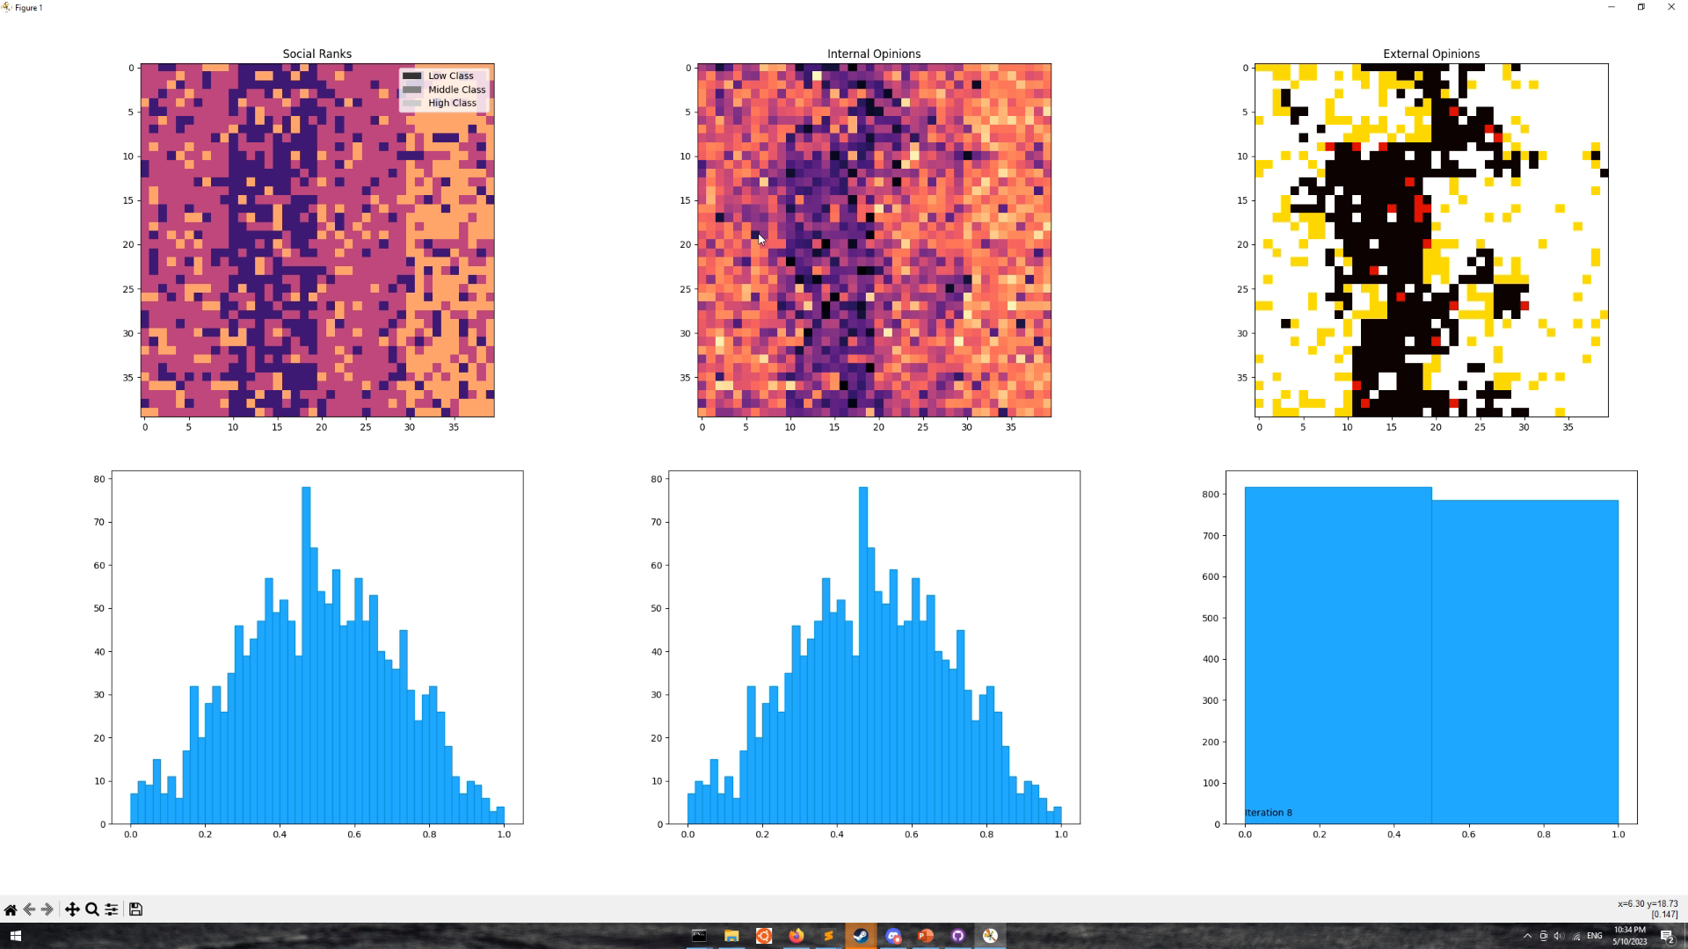
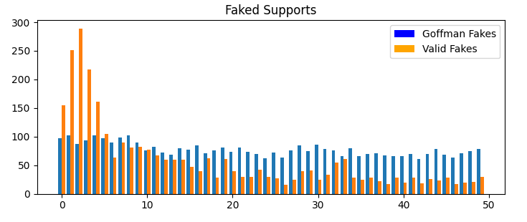
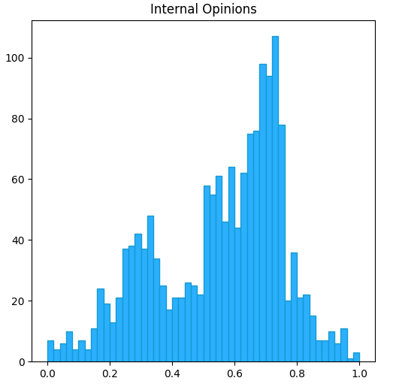
Simulation
Replicating original study
Iteration counts and hardware constraints

Slide 12
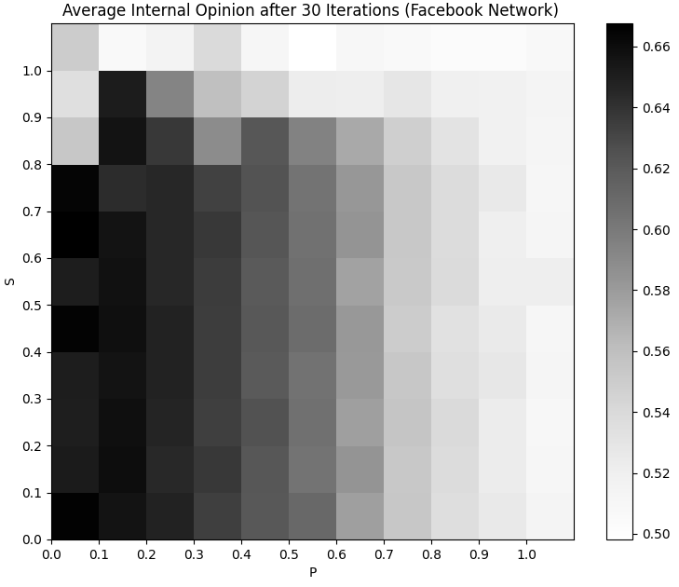
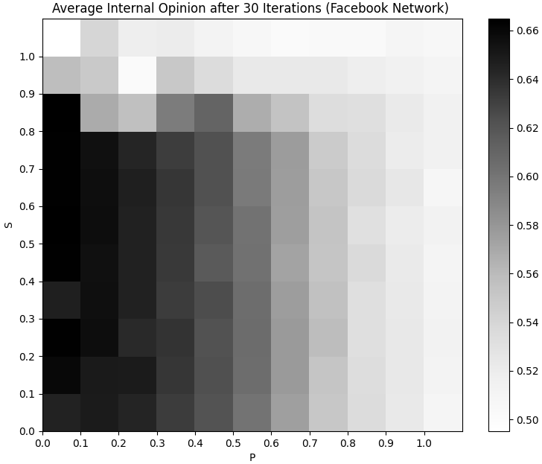
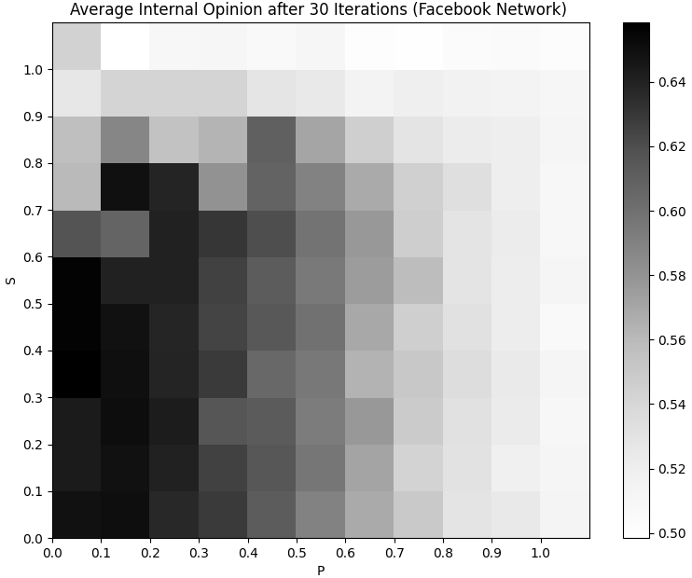
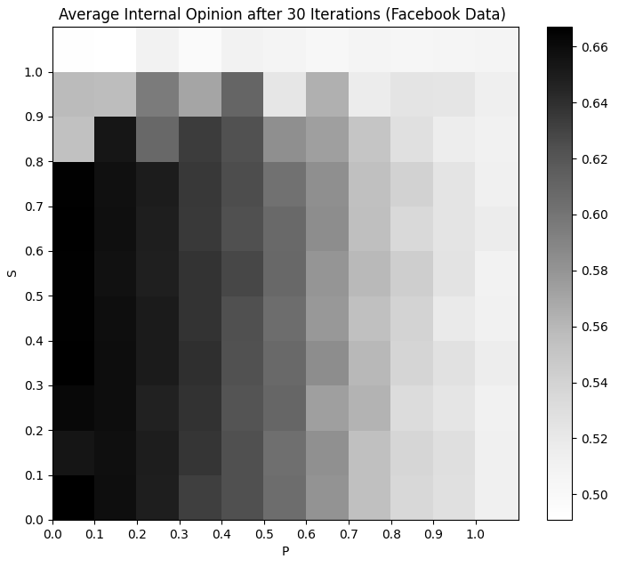
PFS Results
Lattice
70% of edges
(x̄ degree: 30)
50% of edges
(x̄ degree: 21)
30% of edges
(x̄ degree: 13)
Facebook
Notes:
Note on iteration counts

Slide 13
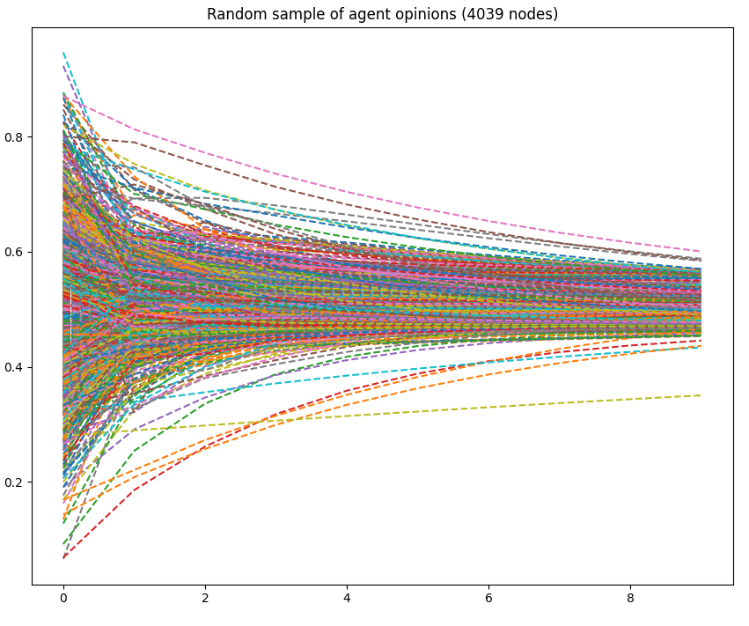
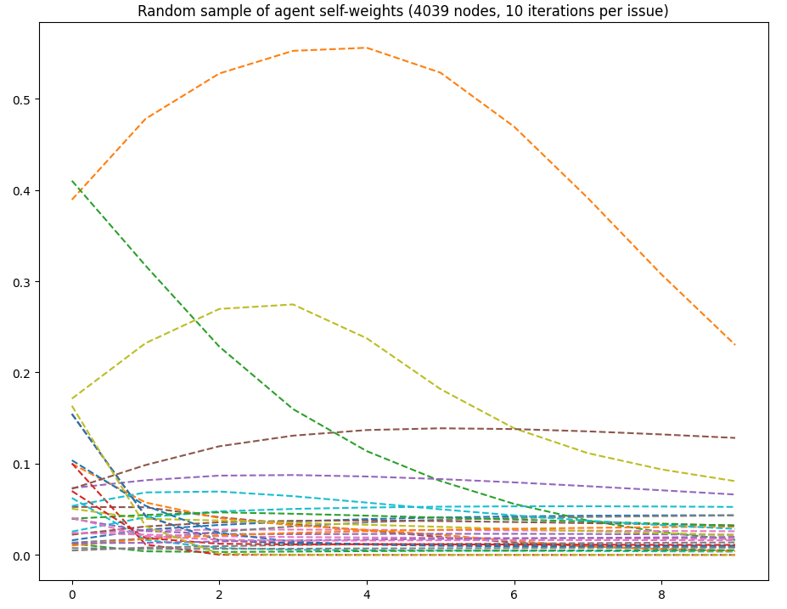
DGF Results
DGF self weights over 10 issues, 100 node complete graph
DGF opinions over 10 issues, Facebook network
DGF opinions over 10 issues, 100 node complete graph
DGF self weights over 10 issues, Facebook network
Notes:
Note on iteration counts

Slide 14
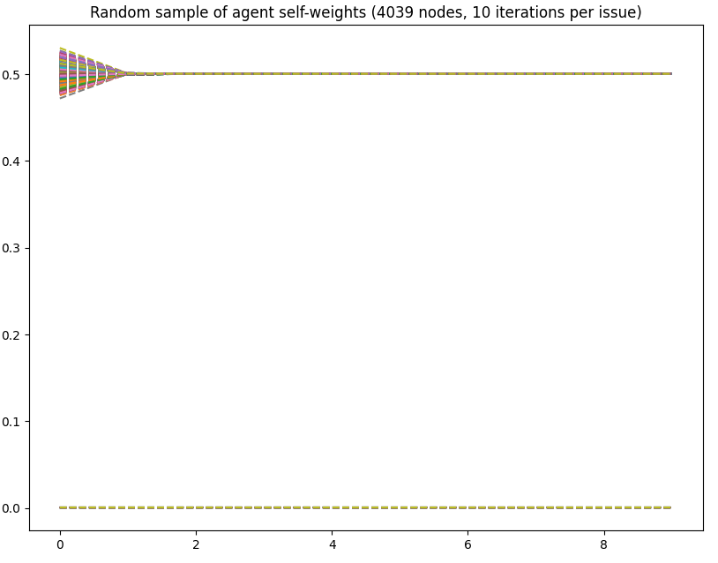
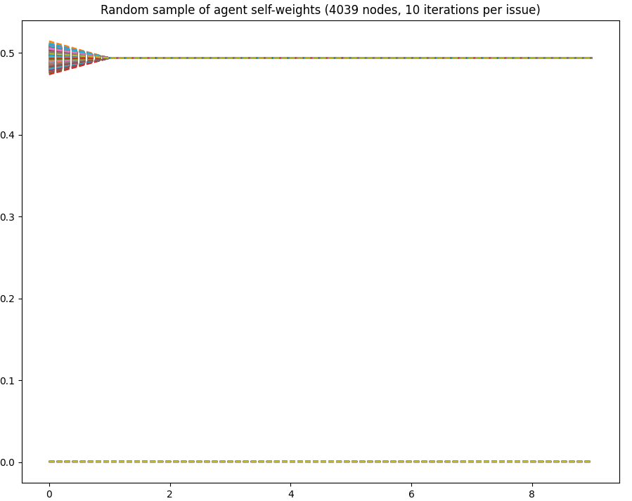
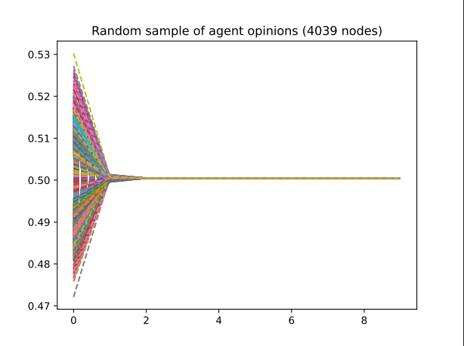
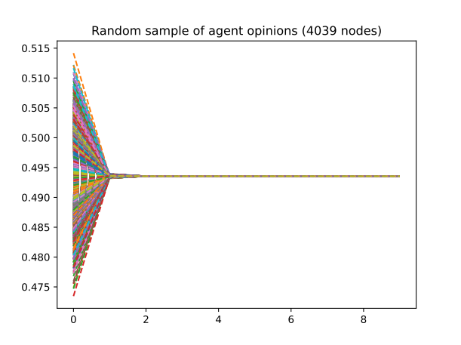
Original Edges
+30% edges
+50% edges
Lattice

Slide 15
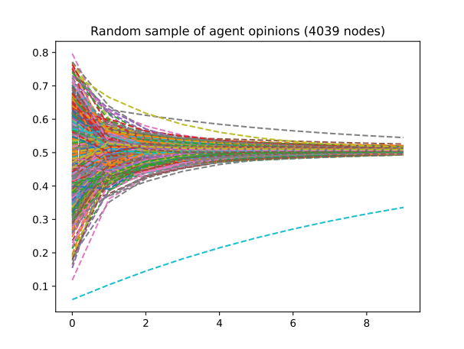
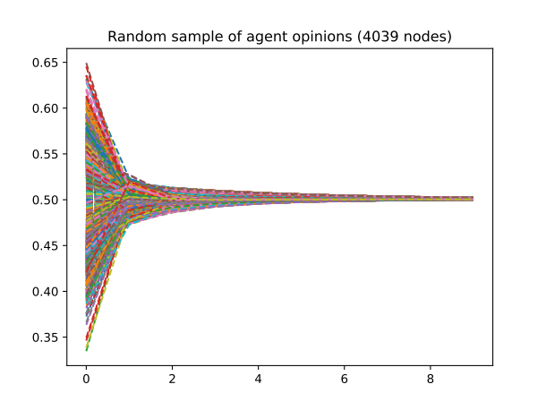
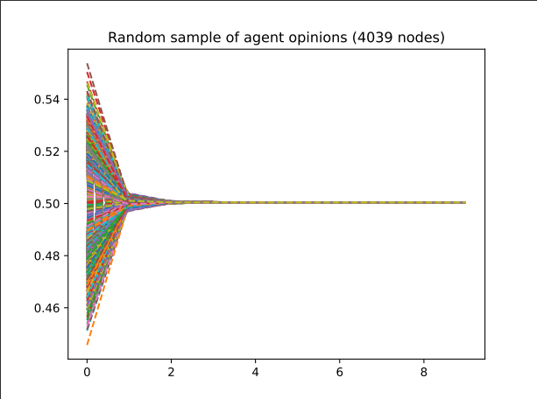
Original Edges
+0.1% edges
+1% edges
+10% edges

Slide 16
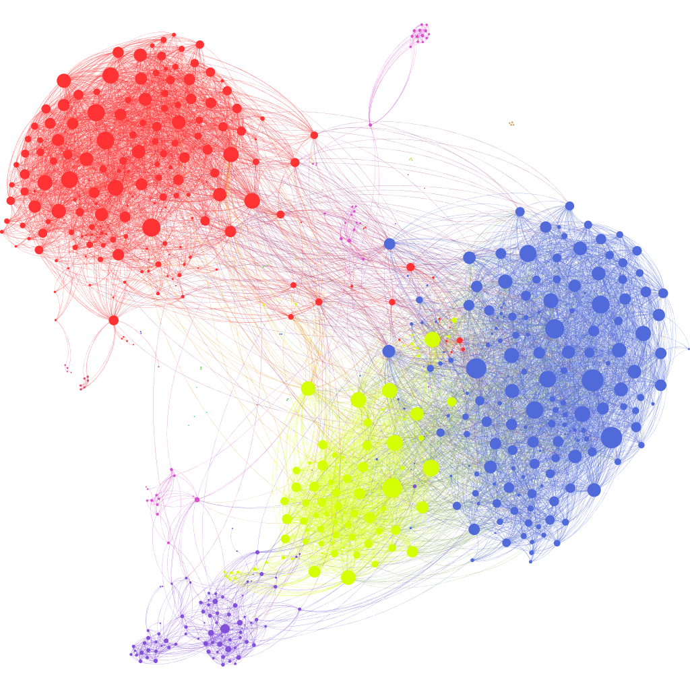
Discussion
Minor changes in outcome but no novel mechanics
Connectivity as the driving factor
Future research
Anonymized Facebook friend graph courtesy of Brendan Griffen
Notes:
Future discussion:
influence networks
more models
more network characteristic studies (complex graph characteristics, triads, stars,

Slide 17
Questions & Fin
Notes:
Future discussion:
influence networks
more models
more network characteristic studies

